Slide 1
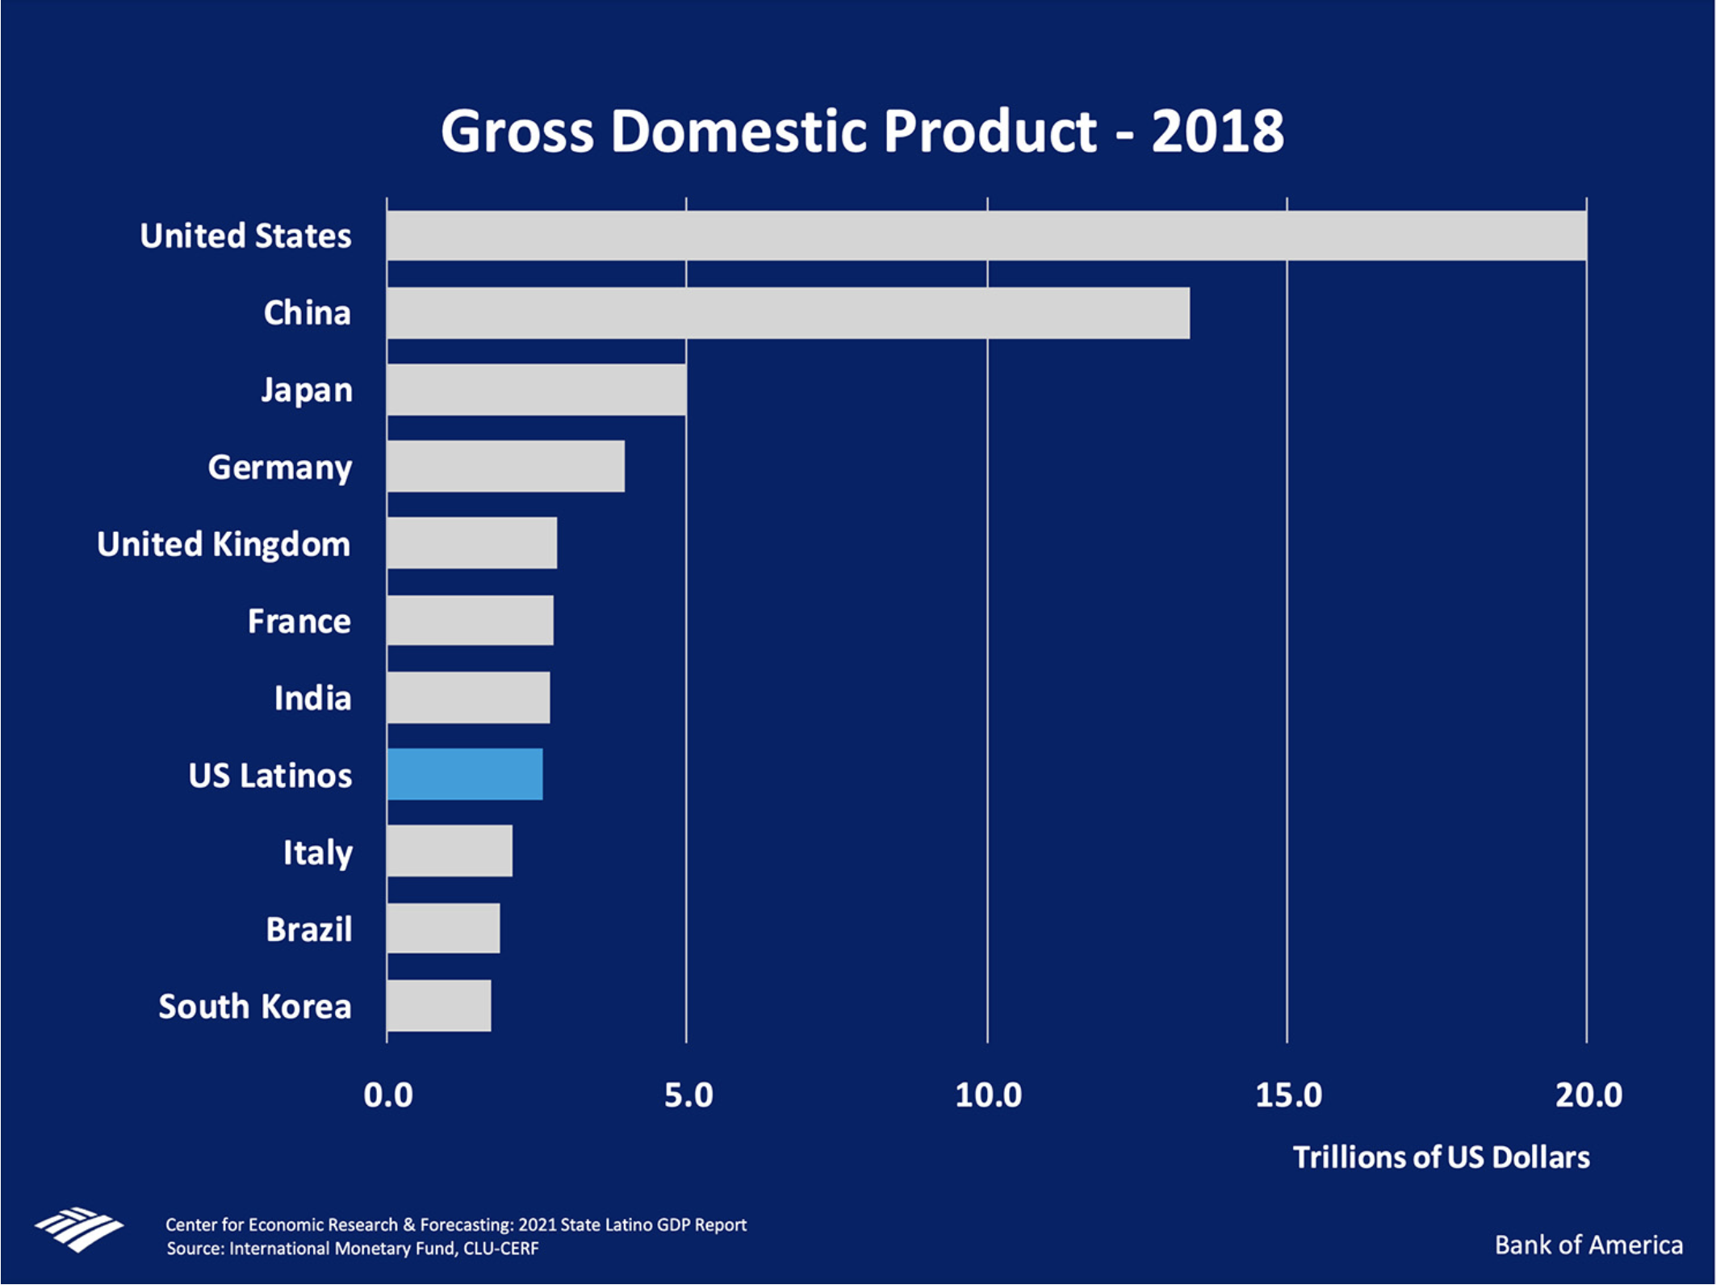

Slide 2
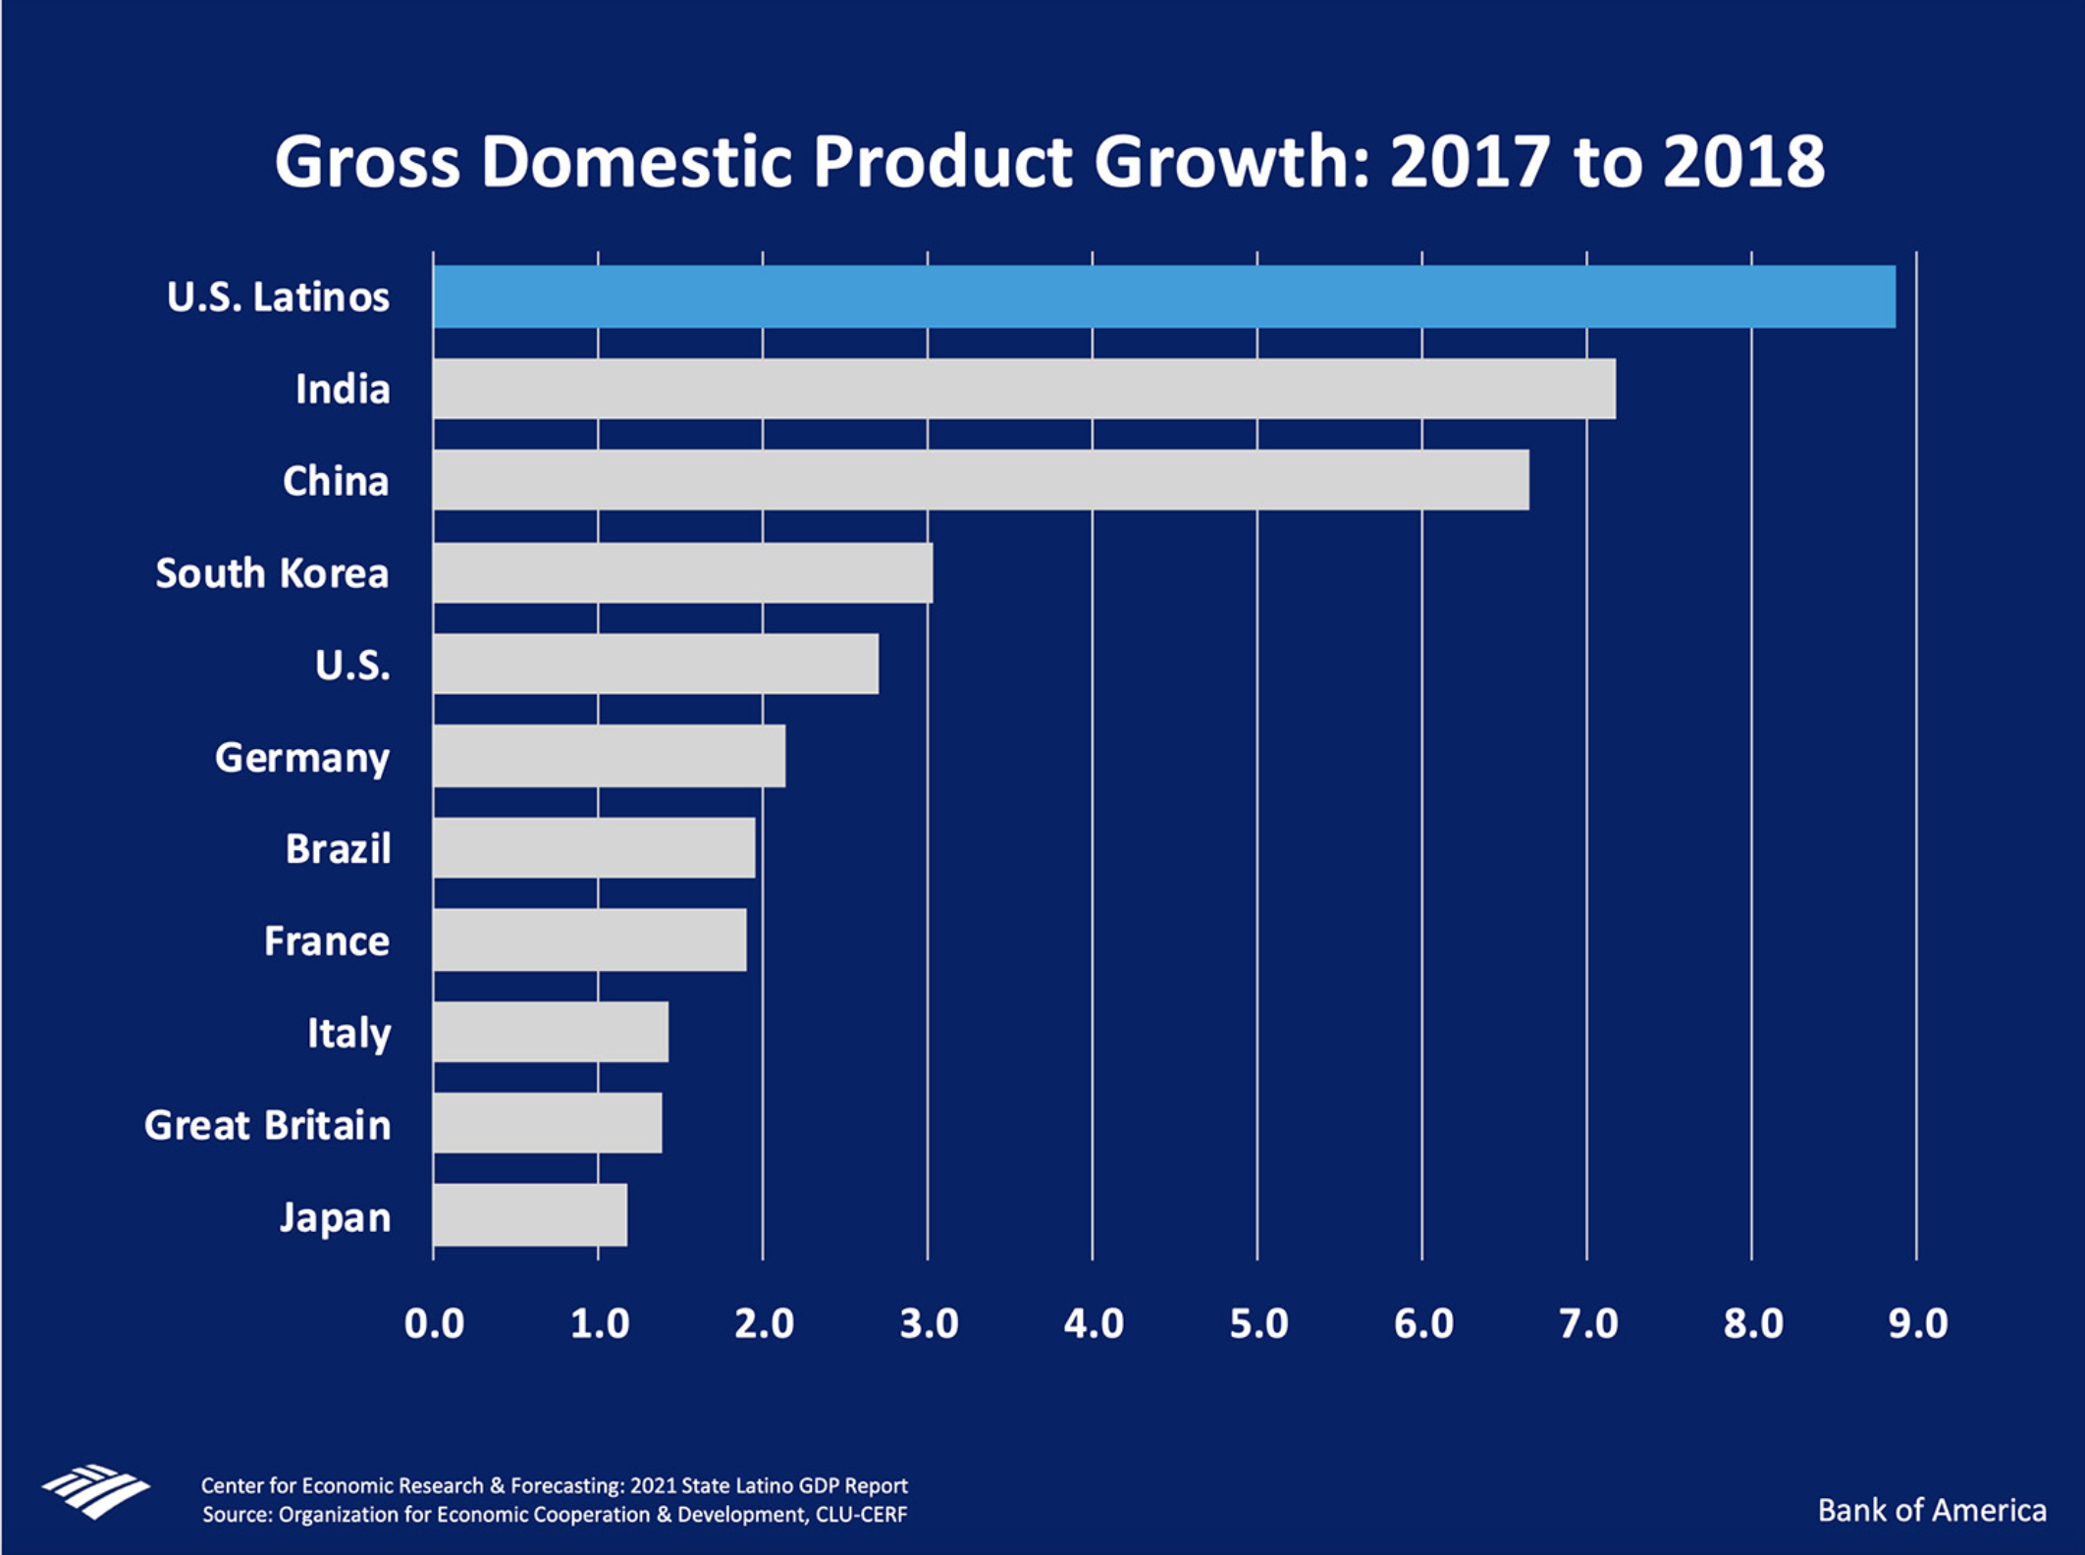

Slide 3
New Growth chart

Slide 5
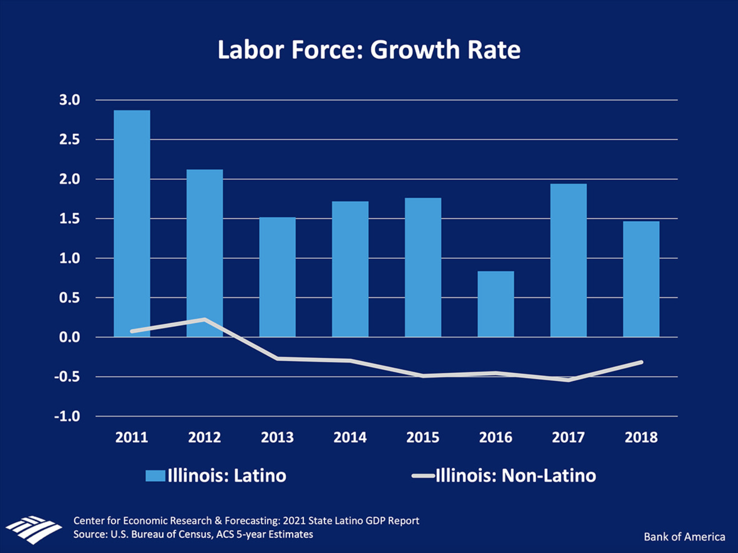

Slide 7
New Latino GDP consumer expenditures

Slide 8
The US Latino GDP and COVID-19
Pressing Through the Pandemic

Slide 9
COVID-19
#1 for Latinos
#3 For NH White

Slide 10
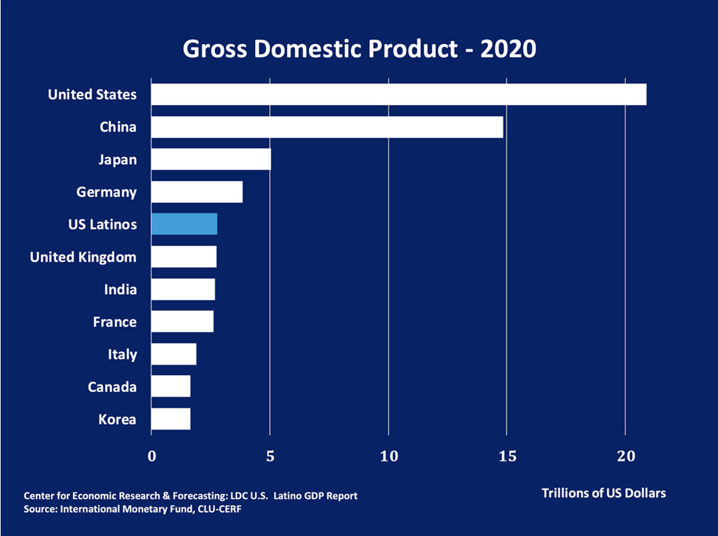

Slide 11
Latinos Pressing Through the Pandemic
Latinos are functional

Slide 12
Latinos Pressing Through the Pandemic
Latinos are functional
Health system is dysfunctional

Slide 13
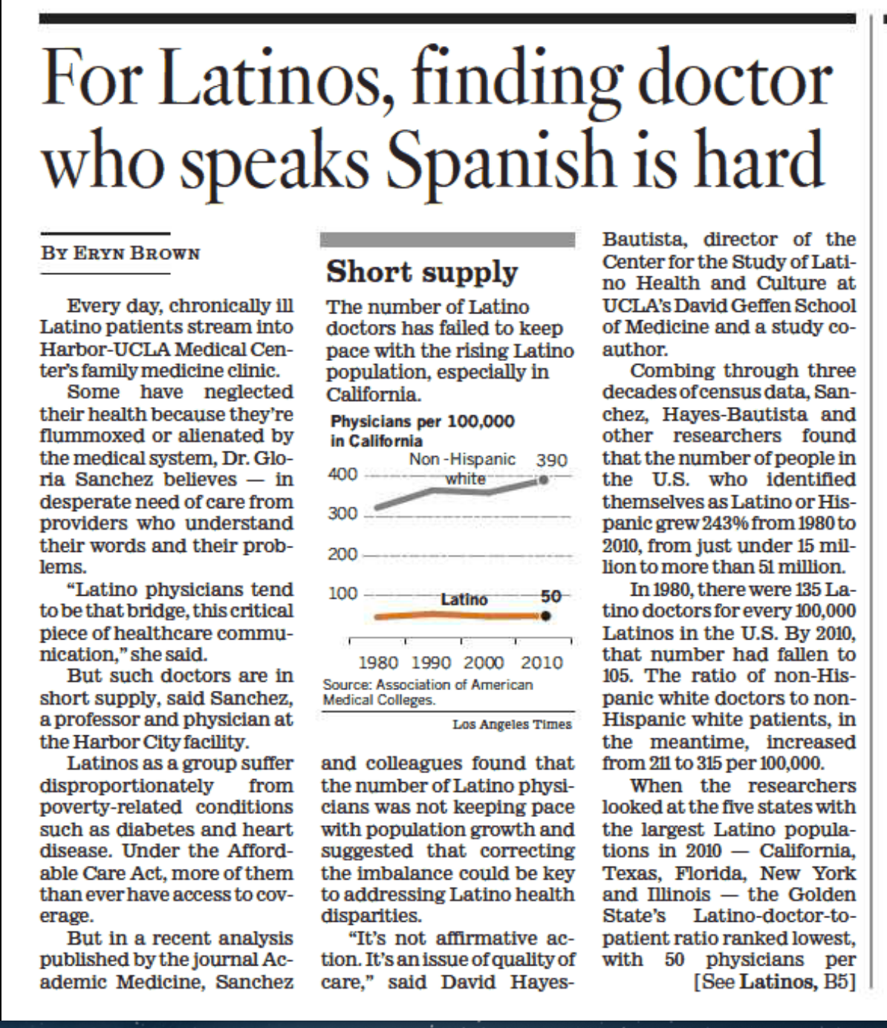
AAMC Latino Physician Shortage

